Slide 1
Health & Safety
Interactive Media
Unit 1

Slide 2
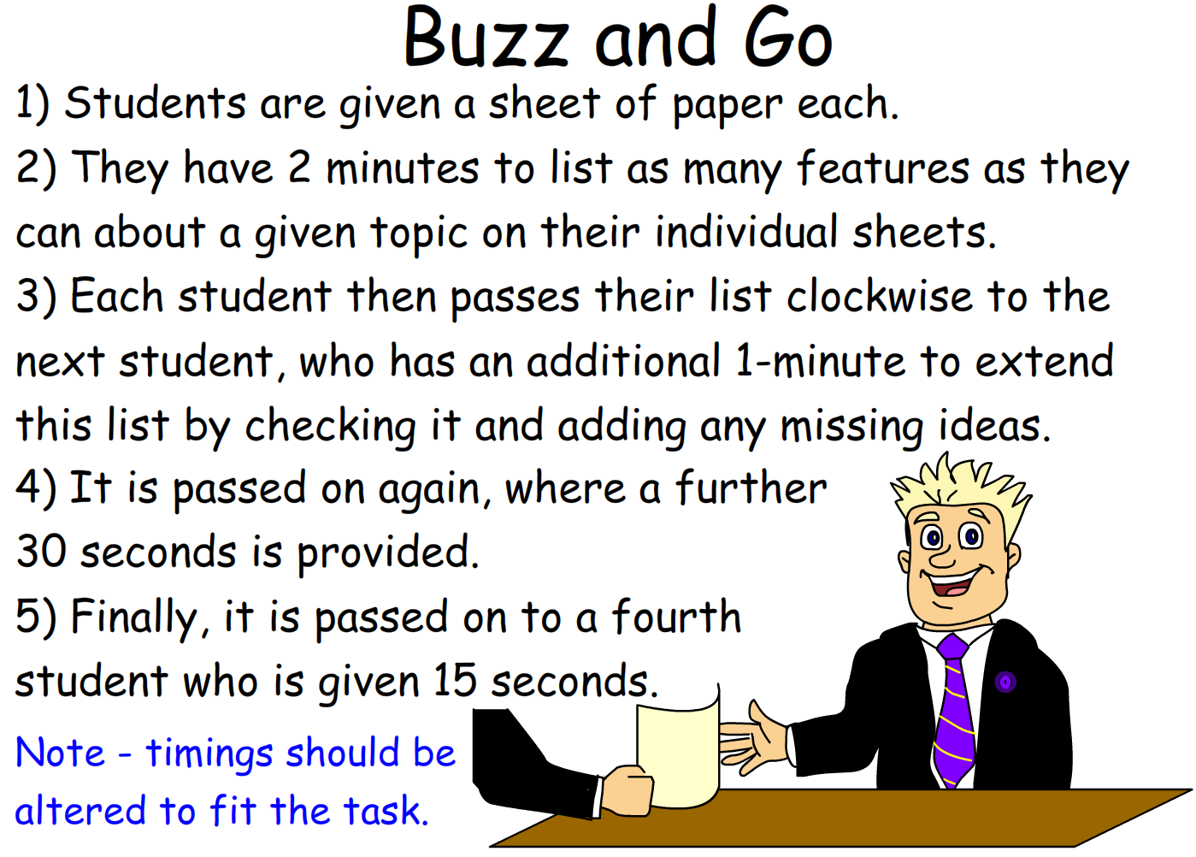
Starter – 5 Minutes
Log in and fill your answers into your worksheet.
List as many different considerations you think should be made when working at a computer for an extended period of time.

Slide 3
Learning Outcomes
Understand the different health and safety precautions that should be taken.
Describe the benefits of using each precaution.
Explain how to actively plan a project with health and safety in mind.

Slide 4
Normal Considerations
In some workplaces, a lot of considerations need to be made for the health & safety of the workforce.
Typically, you may associate this with a job that has a higher risk, i.e. building, a car garage etc.
These don’t really apply to the production of an interactive media product, however there are other considerations.

Slide 5
Are you sitting comfortably?
A key factor in any workplace is the worker’s health, which is going to be affected by their comfort.
If you are uncomfortable, either sitting, standing or walking, it may have adverse effects.
When working at a computer, a whole number of factors can effect the user’s comfort.

Slide 6
Computer Use
From extended (mis)use, computer use can lead to:
Upper back pain
Lower back pain
Repetitive strain injury (RSI)
Leg strain
Foot strain
Eye strain
Headaches
As such, awareness is vital in preventing the problems.

Slide 7
Preventing Back Pain
A common problem from computer use is pain in the upper and/or lower back.
To help prevent it, you should do the following:
Stand up and walk once an hour or so (at the end of a lesson)
Sit up straight in the chair
Don’t lean on one hand/hunch over
Adjust your chair suitably

Slide 8
Portfolio Setup
Create a new heading in your portfolio titled Health and Safety (Heading 1).
You will be doing tasks relating to different health and safety issues, make sure to add a new heading (Heading 2) for each.

Slide 9
Task 1 – Research
Using the internet, research Repetitive Strain Injury (RSI), try and find the following information and note it in your portfolio with the heading Repetitive Strain Injury (Heading 2).
What is RSI? What are the symptoms?
What causes RSI? (From computer use)
What can help prevent RSI?
How can you help prevent RSI in yourself and peers?

Slide 10
Leg and Foot Strain
Another problem working at a computer is the strain on the legs and feet from remaining seated for a prolonged time.
Your feet should sit flat on the floor, with your lower legs vertical.
To help prevent it, you should do the following:
Rotate your ankles in circles under the desk
Stand up once an hour or so to increase blood flow
Don’t sit with your legs crossed over each other

Slide 11
Eye Strain and Headaches
A major problem with any activity using screens, e.g. computer or mobile phone use is the effect on the eyes and the head.
Various factors influence the eye strain:
Glare from lights or windows on the screen
Unclear screen from dust or smudges
Proximity to screen – screen should be your out-stretched arm’s length away
Extended use – Focus on something in the distance every half hour or so

Slide 12
Task 2 – Health Issues
For each of the health problems below, list the following in your portfolios (each under their own heading):
Causes of the problem
Symptoms of the problem
Mitigations for the problem (How to stop it before it happens)
RSI
Leg and foot strain
Eye strain and headaches
Upper and lower back pain
Any other relevant health issues

Slide 13
Task 3 – Mood Board
Produce a mood-board to show your understanding of the health & safety problems when working with computers.
Include text and images.
Include explanations of the problems.
Explain how to help prevent the problems.
Include annotations of the images.

